Slide 1
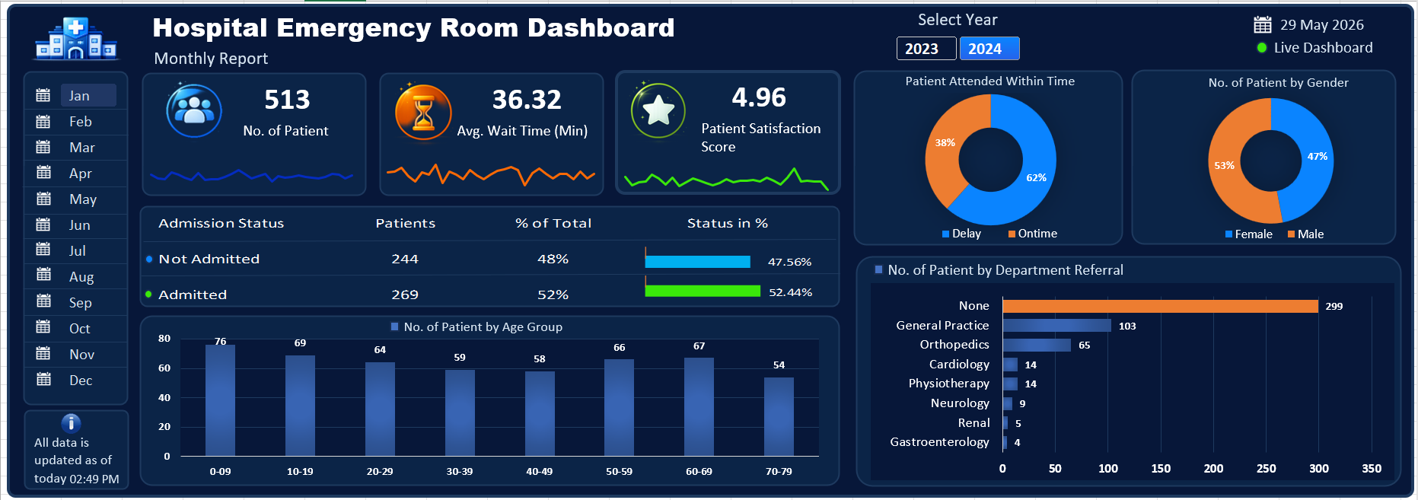

Slide 2
Project Steps
Business Requirement Gathering
Understanding of Data
Data Connection (Import Data Using Power Query)
Data Cleaning and Data Quality Check Using Power Query
Creating Calendar Table using Power Query
Data Modeling – Power Pivot
Adding Required Columns (DAX Calculation in Power Pivot)
Creating Pivots and Dashboard Lay outing
Charts Development and Formatting
Dashboard / Report Development
Insights Generation

Slide 3
Purpose of Project The purpose of this project is to analyze hospital emergency room data and transform raw data into meaningful insights using an interactive Excel dashboard. This dashboard helps track patient statistics, wait time, satisfaction score, admission status, and department referrals through data visualization and analytics techniques.

Slide 4
KPI’S Requirement
Number of Patients: Count the total number of patients visiting the ER each day. Show a daily trend with an area sparkline to spot patterns like busy days or seasonal trends.
Average Wait Time: Find the average time patients wait to see a medical professional. Use an area sparkline to track daily changes and highlight days with longer wait times that might need improvements.
Patient Satisfaction Score: Check the average daily satisfaction score of patients to assess service quality. Use an area sparkline to show trends, spot drops in satisfaction, and link them to busy times or challenges.

Slide 5
Charts to Create Patient Admission Status: Show how many patients were admitted vs. not admitted. Patient Age Distribution: Group patients by age. Timeliness: Measure the percentage of patients seen within 30 minutes. Gender Analysis: Display the number of patients by gender. Department Referrals: Check which departments patients are referred to the most.

